Slide 1
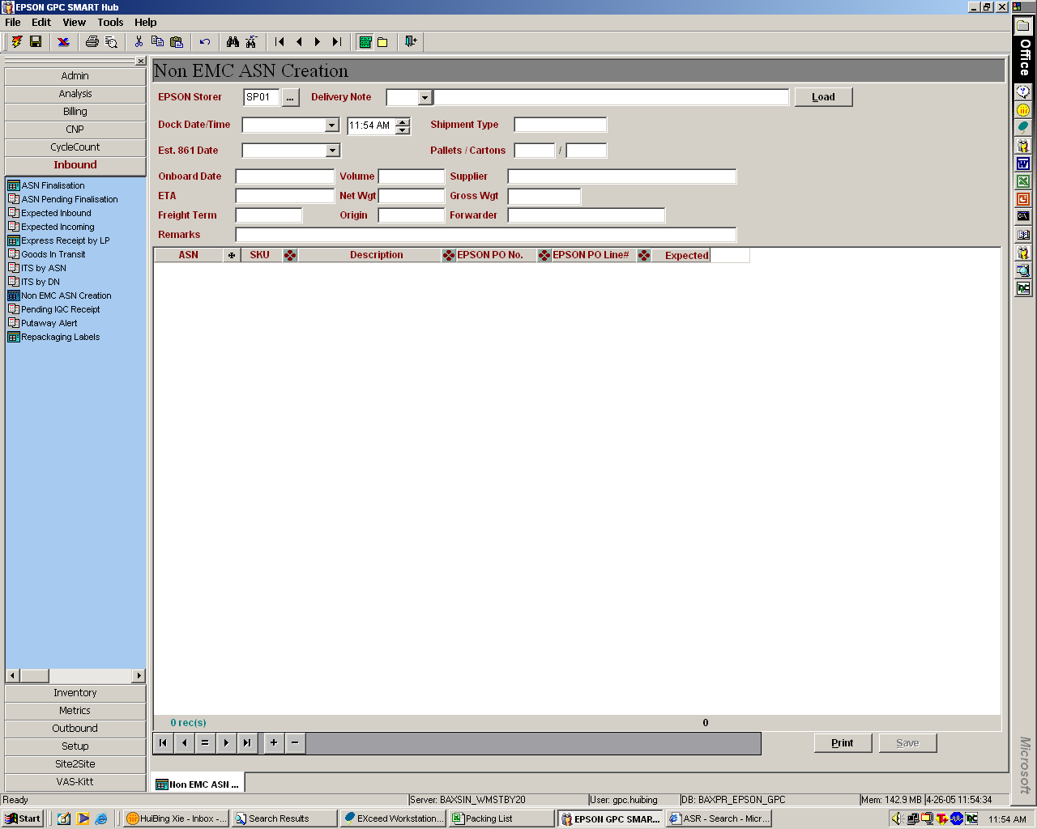
Current: “Expected” field -Quantity is populated upon EPSON PO Line Selection
Change To: Field to remain blank for user input.
To block subsequent new line creation and flag error message if “Expected” field of previous line is blank
Additional Request:
- To have a “Release” function. Upon execution, GenXP file to be generated and released to Epson. Logic should be similar to the existing ‘Save’ icon.
Current Practice: GenXP file is generated and released to Epson upon saving
Change To: Allow the details to be saved without generating the GenXP files.

Slide 2
ASN Creation-Pending GenXP Release
 | ASN | SKU | EPSON PO No. | EPSON PO Line No. | Expected | COO
 |  |  | GDN5ABB28112
1 | 0000168211 | 1032301 | 4500072467 | 00010 | 30 | JP
2 | 0000168941 | 2130421 | 4500086201 | 00230 | 100 | CN
 |  |  | GDN5ABB28101
1 | 0000156879 | 2412365 | 4500023456 | 00090 | 20 | JP
New Report
To show all invoices pending for GenXP file release to Epson

Slide 3
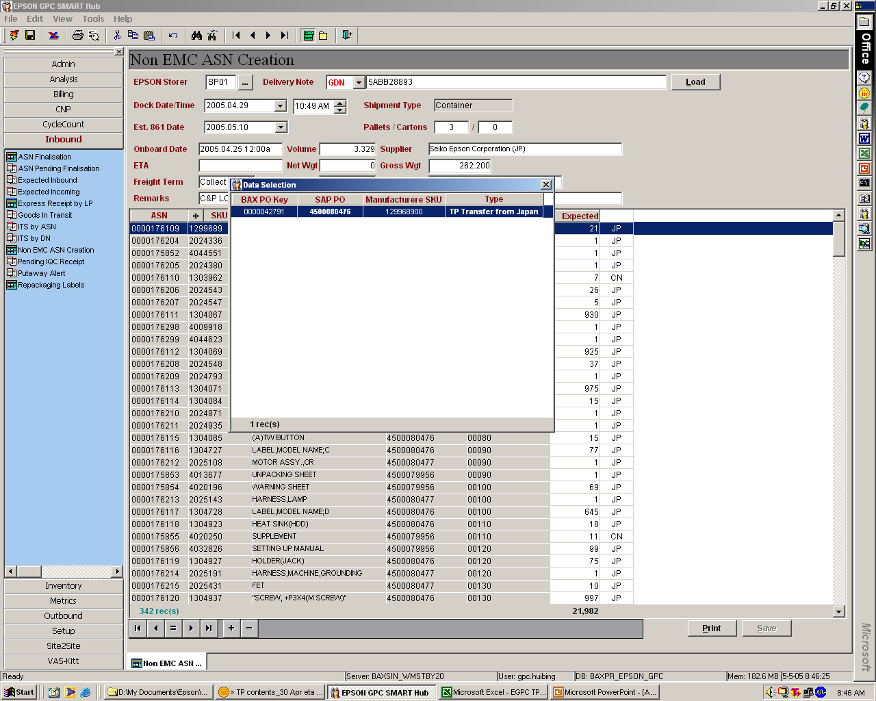
1) Enlarge the data selection screen for the
following fields:
- EPSON PO No.
- EPSON PO Line #
2) Enlarge the fonts accordingly, especially
the ‘SAP PO’ and ‘SAP PO Line#’

